Slide 1
ECE/CS 552: Project Phase 3
Boone Severson

Slide 2
Objectives
Phase 1
Single-Cycle Processor
Phase 2
Transform Phase 1 → Pipelined 5 cycle processor
Register File (and Flags) Bypass
Data forwarding for ALUs EX-to-EX, MEM-to-EX
Data forwarding for Store Data MEM-to-MEM
Hazard Detection for Branch and Load-to-Use

Slide 3
Objectives
Phase 3
Replace imem/dmem with memory hierarchy
Hierarchy consists of Icache, Dcache, and common Memory
cache.v
2048B, 2-way set-associative, 16B blocks
Caches can cause processor pipeline stalls on miss
Write-Allocate – if write !hit, fill cache before writing data_way
Write-Through – hit: write data_way & main memory in parallel

Slide 4
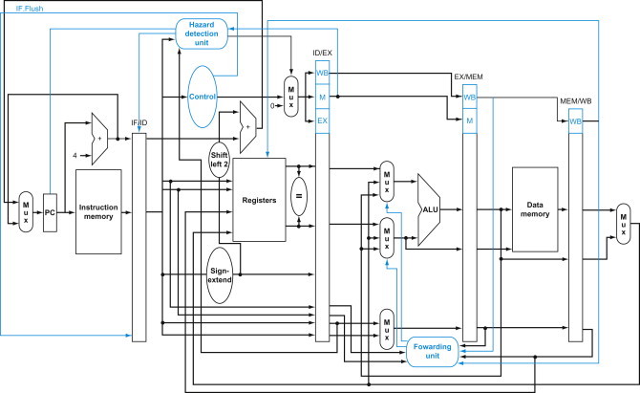
Cache Hierarchy
L1-I cache
L1-D cache
cache_fill_fsm
main memory (memory4c)

Slide 5
Caches - Conceptual
Standard hash function:
physical address
tag | set | offset
way 0
way 1
way 0
way 1
tag |  | tag |  | data |  | data
 |  | X |  |  |  | (X)
hash function
set
tag
hit?
hit?
=
=
block offset
<<
data

Slide 6
Caches - Physical
metadata_way_array.v
Operates like single-port RF (one-hot set_enable)
Read cycle
set_enable causes that set to drive data_out immediately
set_enable == 0? .data_out is ‘hz
Write cycle
wen is broadcast to all sets, but set_enable only causes that set enabled to write (on next posedge)
wen w/o set_enable? No write happens.

Slide 7
Caches - Physical
data_way_array.v
Operates like 2D RF, one-hot set_enable & word_enable
Read cycle
Requires set_enable and word_enable simultaneously
set_enable selects a set of 8 words, word_enable drives that word to data_out immediately
0 on either set_enable or word_enable causes high-z output
Write cycle
wen + set_enable + word_enable writes data_in to that word (on next posedge)

Slide 8
2-way Set Associativity
Instantiate 2 metadata_way_array and 2 data_way_array instances per cache
16-bit address → {tag,set,word,1’b0}
What are the sizes?
2048 bytes total, 16B blocks, 2-way
Detect hits in a metadata_way_array
{tag, valid, LRU}

Slide 9
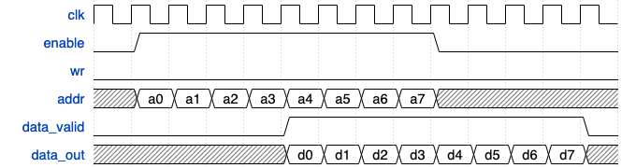
memory4c.v
4 clock pipeline addr→data

Slide 10
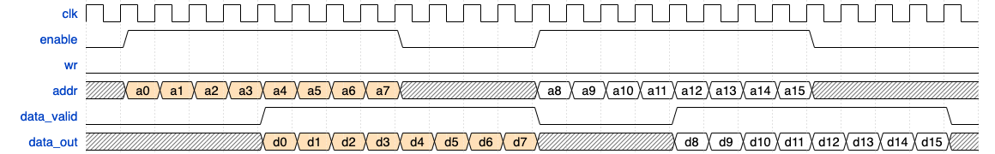
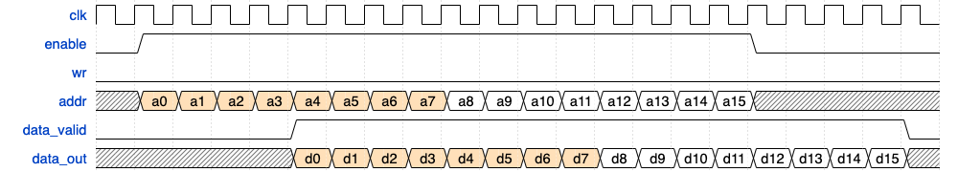
Back-to-Back reads
Not pipelined 😒
Pipelined 🔥
Pipelining achieves 100% memory bandwidth

Slide 11
Implementation Hints
Follow the Verilog Rules on all modules
Shift registers can allow overlap while a single counter cannot
6 bits to one hot? Make a 6-stage Barrel Shifter
index[5] indicates <<32 or <<0, and so forth
If stage is stalled, all cache inputs will remain the same
e.g. During a fill, addr can be used until fill is complete

Slide 12
Implementation Hints
Decide where canonical LRU bit is held
This means one way is always updated for LRU bit even if other way is getting the tag & valid bits
If unit testing is important to you, create memory_system.v module
icache, dcache, memory4c
Enables testing of logic and wiring between caches and memory4c w/o the rest of the processor
Makes replacing memory1c in cpu.v a breeze

Slide 13
Stalls
Caches can stall, what should the CPU do?
Icache stall causes F* - what about DXMW?
Dcache stall causes M*
What about FDX? W?
SUB R0, R4, R1
B 000, FAIL
ADD R5, R5, R3
SUB R1, R1, R3
B 000, CHK_LP
LW R2, R6, 0
LLB R1, 0X8A
SUB R0, R1, R2
B 000, FAIL

Slide 14
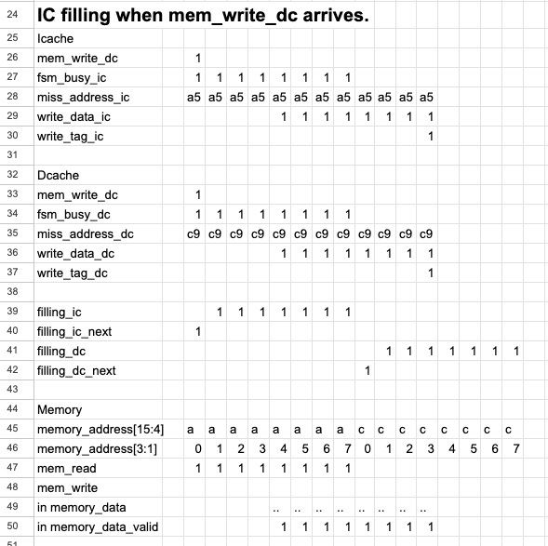
Implementation Hints
Make Pipeline Diagrams!

Slide 15
Testing Hints
HW8’s cache_fill_fsm supports 1 upstream L1
Make a TB that has cache.v, hw8_cache_fill_fsm, and memory4c to test cache.v as a Dcache
Test filling 64 sets and both ways, then reading them back out
Cache must stall until it returns requested word
Test filling w/write to uncached block (write-allocate)
Initialize memory at runtime
Could write memory4c.mem[addr] = addr, or $urandom if you store a shadow copy

Slide 16
Testing Hints
Use $readmemh only for fixed data
Let stimulus write just the addresses you need.
If you read tag(0) set(0) word (3), address is 0x6. Cache will pull in the full block. Pattern w/addr
addr[`TAG_ADDR] = tag;
addr[`SET_ADDR] = set; addr[0] = 1’b0; for (int i=0; i<8; i++) begin
addr[`WORD_ADDR] = i;
memory4c.mem[addr] = addr;
end

Slide 17
Testing Hints
Once dcache_tb.v works, make twocache_tb.v
Corner cases?
Holds 128 cache blocks assuming 2 tags per set
Write to invalid ways first
Overwrites the LRU way if both ways valid

Slide 18
Speed Up Development ONLY
data_way_array and metadata_way_array are modeled like RF – but Icarus Verilog takes 2 minutes to compile my phase3 TB.
Faster models can be used for development if your Verilog Simulator takes too long to compile. See next 2 slides
These models will not catch if one-hot inputs are >1 hot. Do not turn these files in. When I simulate your processor, if these are selected I will revert to non- *_beh modules.

Slide 19
// ECE/CS 552 Data Array Design File (Behaviorial)
// Data Array with 64 sets
// Each set will have 8 words
// set_enable and word_enable are one-hot
// wen is 1 on writes and 0 on reads
module data_way_array_beh (
input clk,
input rst,
input [15:0] data_in,
input wen,
input [63:0] set_enable,
input [7:0] word_enable,
output [15:0] data_out
);
logic [6:0] set_index;
logic [2:0] word_index;
logic [15:0] sets[64][8];
assign data_out = ~wen & |set_enable & |word_enable ? sets[set_index][word_index] : 16'hz;
always_comb begin
set_index = -1;
for (int i = 0; i < 64; i++) begin
if (set_enable[i]) begin
set_index = i;
//break;
end
end
word_index = -1;
for (int j = 0; j < 8; j++) begin
if (word_enable[j]) begin
word_index = j;
//break;
end
end
end
always @(posedge clk) begin
if (rst) begin
for (int i = 0; i < 64; i++) for (int j = 0; j < 8; j++) sets[i][j] <= 0;
end else begin
if (wen & |set_enable & |word_enable) sets[set_index][word_index] <= data_in;
end
end
endmodule

Slide 20
// ECE/CS 552 Metadata (aka Tag) Array Design File (Behavioral)
// Tag Array with 64 sets
// Each set stores 8 bits for tag, valid, and LRU bit.
// set_enable is one-hot
// wen is 1 on writes and 0 on reads
module metadata_way_array_beh (
input clk,
input rst,
input [7:0] data_in,
input wen,
input [63:0] set_enable,
output [7:0] data_out
);
logic [7:0] sets[64];
logic [6:0] set_index;
assign data_out = ~wen & |set_enable ? sets[set_index] : 8'hz;
always_comb begin
for (int i = 0; i < 64; i++) begin
if (set_enable[i]) begin
set_index = i;
//break;
end
end
end
always @(posedge clk) begin
if (rst) begin
for (int i = 0; i < 64; i++) sets[i] <= 0;
end else begin
if (wen & |set_enable) sets[set_index] <= data_in;
end
end
endmodule

